Slide 1
Serverless with Webtask

Slide 2
Building Stupid Stuff for Fun and Games (and Learning) but Mainly for Fun!

Slide 3

I'm Ray
raymondcamden@gmail.com
raymondcamden.com
@raymondcamden
Jobless Bum (hire me so I can feed my 200 kids and animals)

Slide 4
What is Serverless?

Slide 5


Slide 6


Slide 7
Building Cool Crap Easily and Quickly

Slide 8
Example 1 - Contact Fixer
(Not serverless but that's ok...)

Slide 9
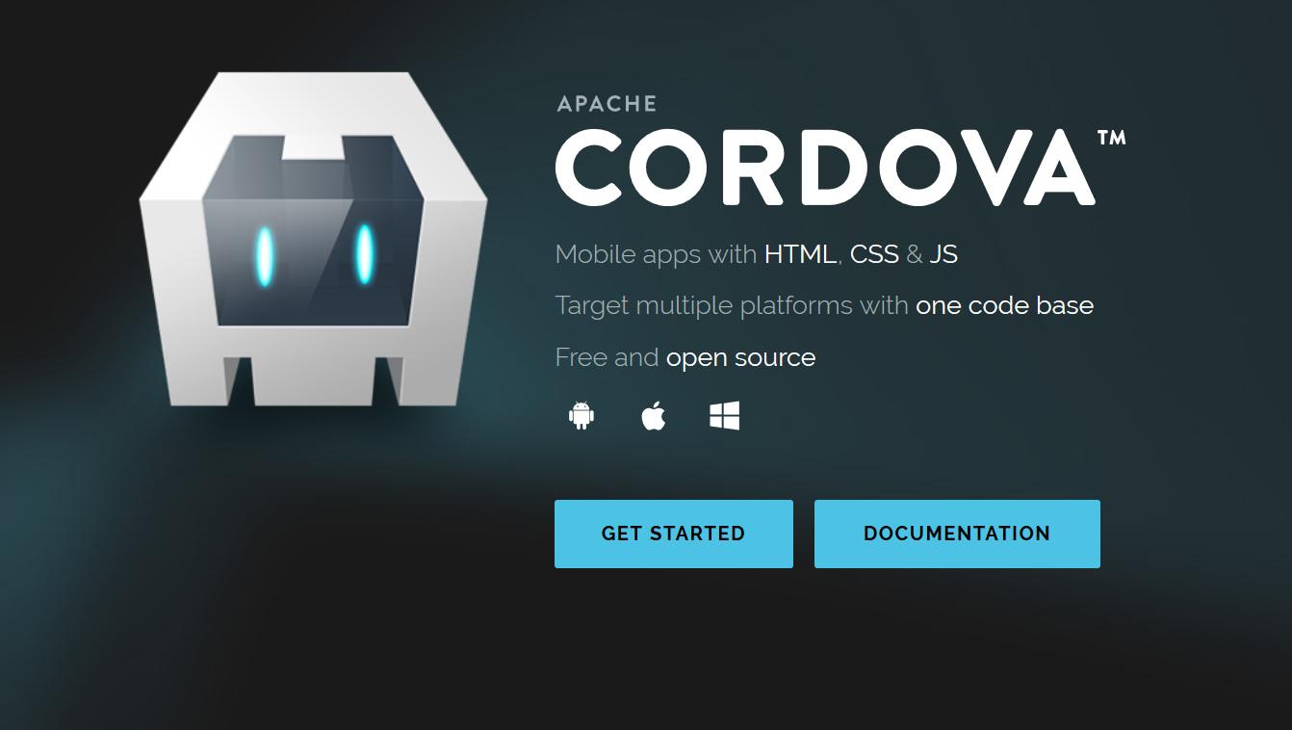

Slide 10
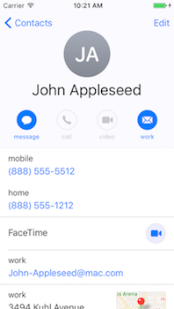
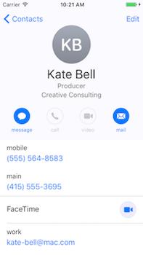
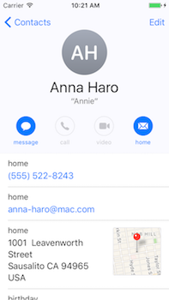

Slide 11
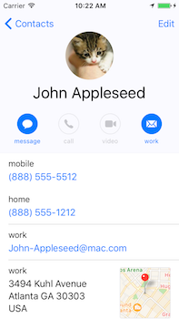
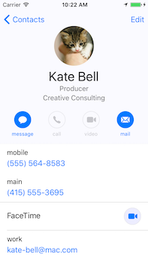
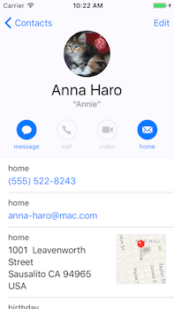

Slide 12
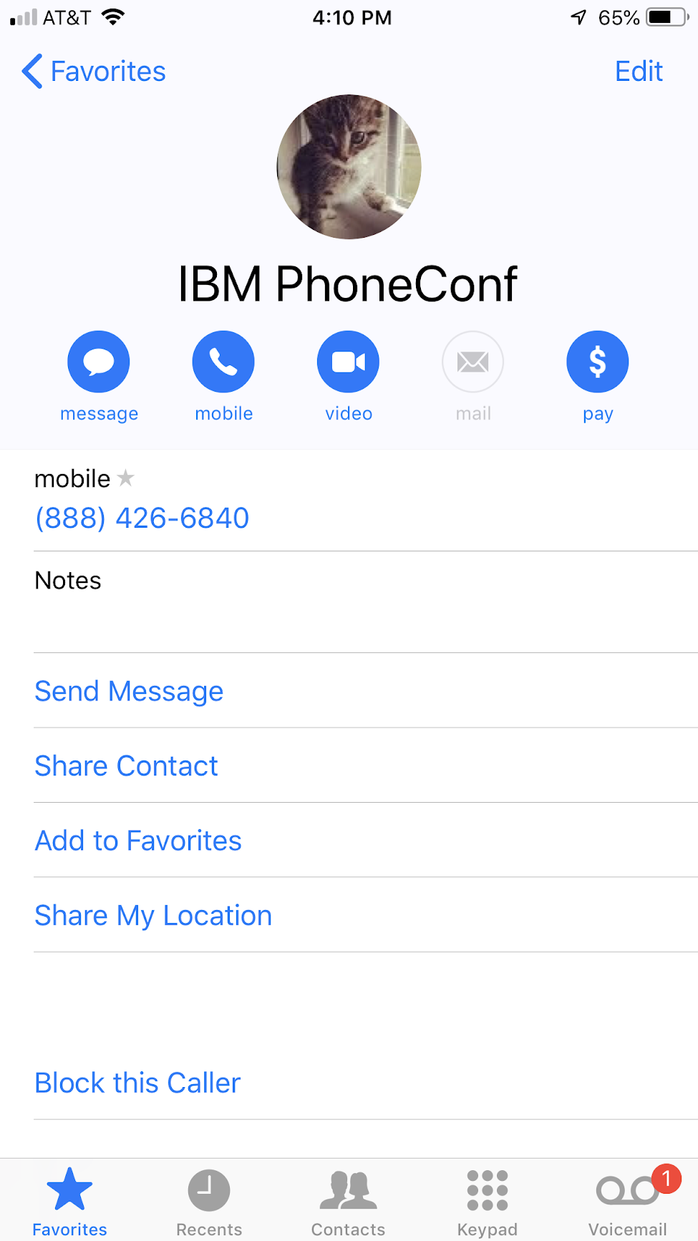

Slide 13
Example 2 - Random Comic Books
(Serverless!!)

Slide 14


Slide 15


Slide 16


Slide 17


Slide 18


Slide 19
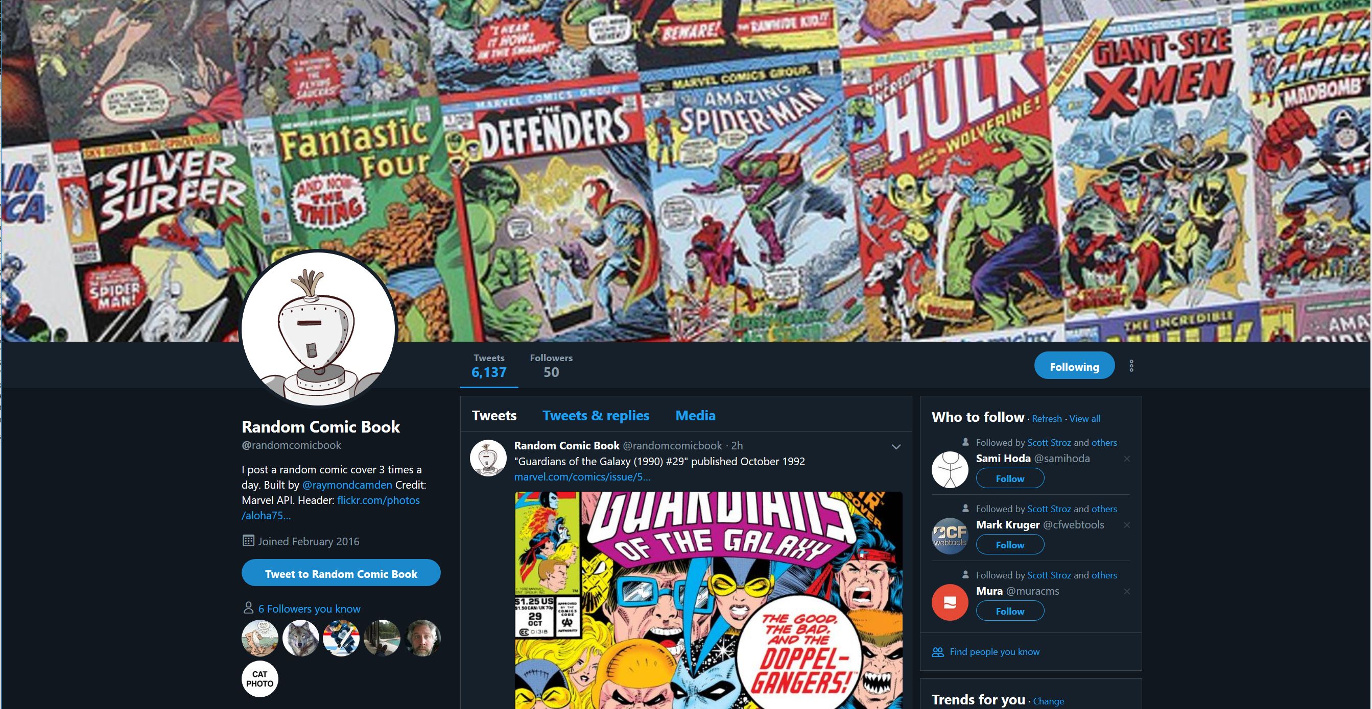

Slide 20
Can we get to a point?
Please?

Slide 21
A Point
Every programming language does the same dang thing
Every platform supports the same thing
Some languages / platforms are more inviting then others

Slide 22
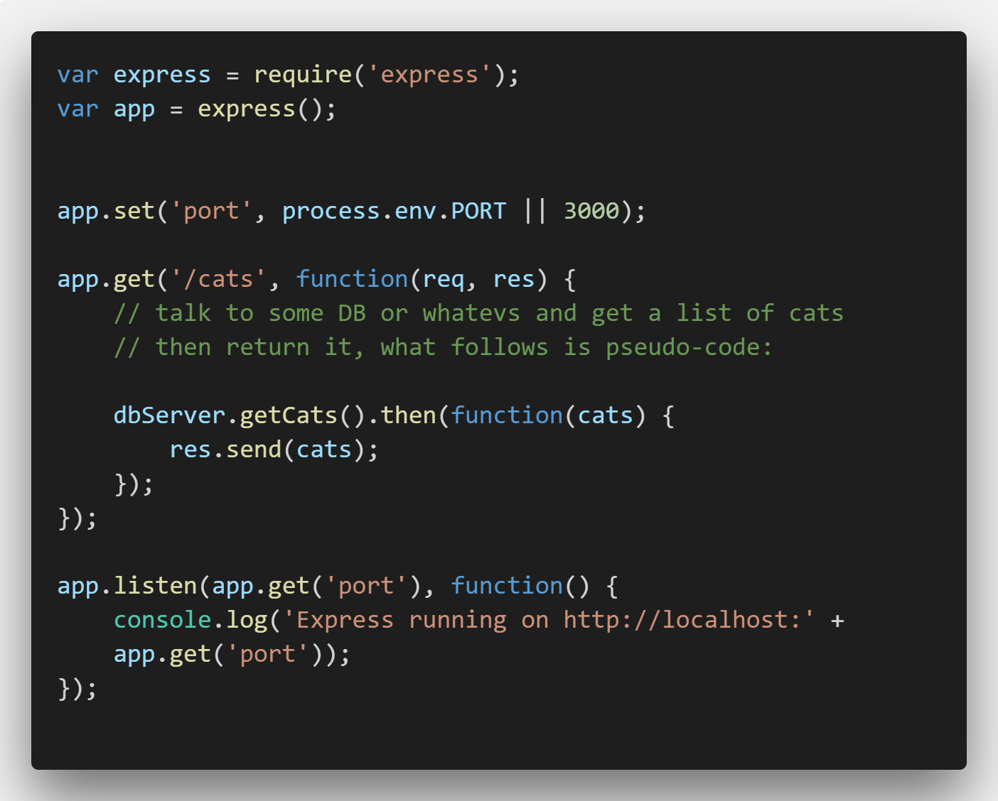
Not Serverless

Slide 23
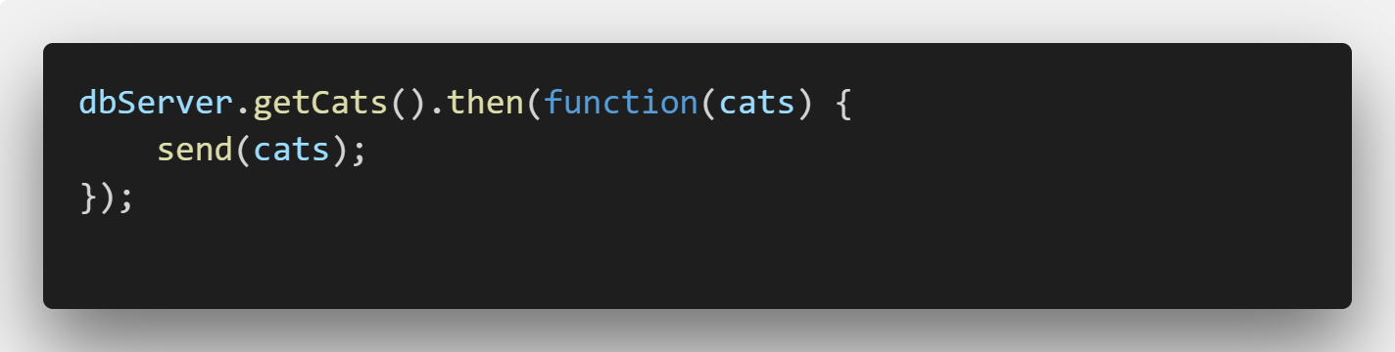
Serverless

Slide 24
Serverless with Webtask
Free to use
Sign up via Facebook, Google, GitHub, and Microsoft
Easiest serverless platform out there
Not the best platform
webtask.io

Slide 25
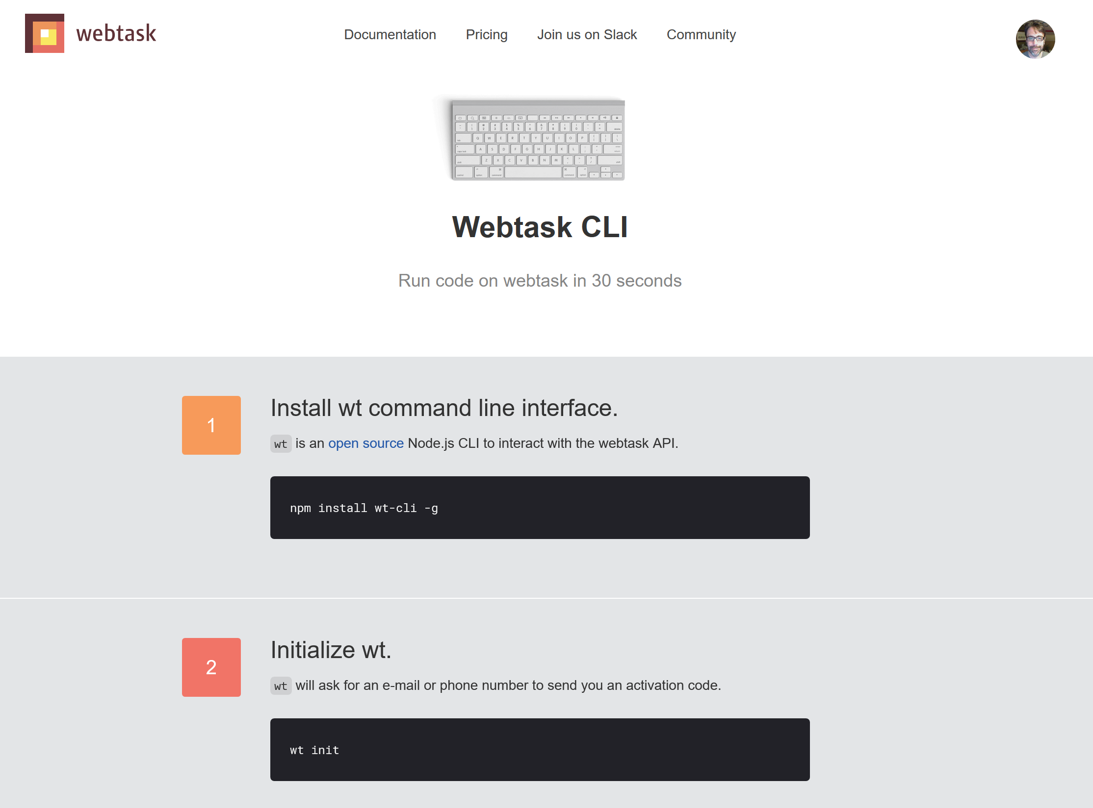

Slide 26
About that CLI...
Does everything I'm showing today
But I'm not showing it
You can work locally, test, debug
You can use your favorite editor
which is Visual Studio Code

Slide 27
Webtask Editor
https://webtask.io/make
List your files (and search)
Make new files (and delete stinky old ones)
Open files (duh), edit, full screen
Syntax highlighting, ESLint, Prettier
Dark theme!
Oh, and a full testing environment

Slide 28

Editor Tour!!!

Slide 29
Make the Serverless
Create the Webtask
Done*
* Some details may apply

Slide 30
Writing Webtasks
Three basic "forms" of your Webtask
JavaScript
Simple to Hipster Fancy Stuff

Slide 31
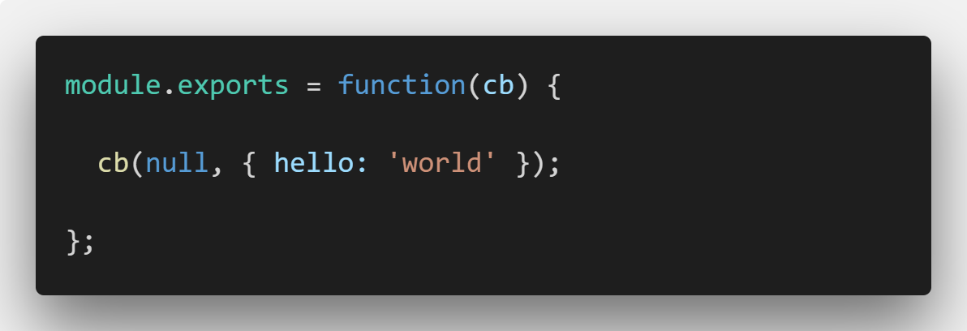
Basic Function Form

Slide 32
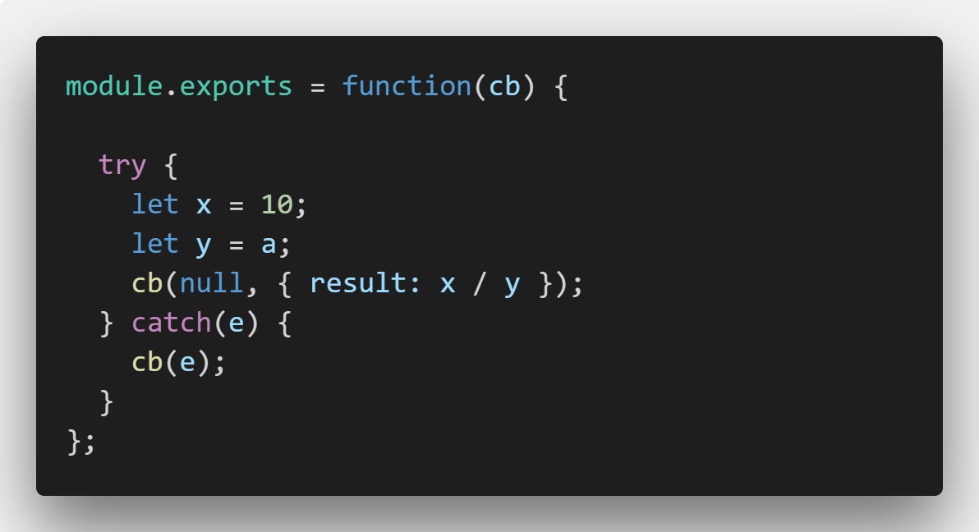
Basic Function Form

Slide 33
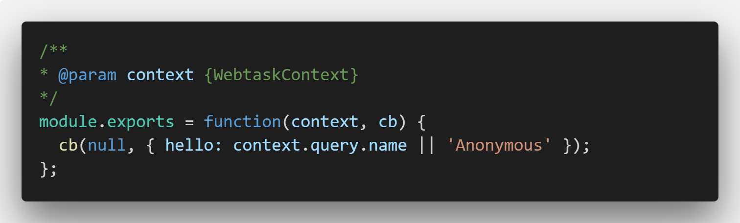
Context Form

Slide 34
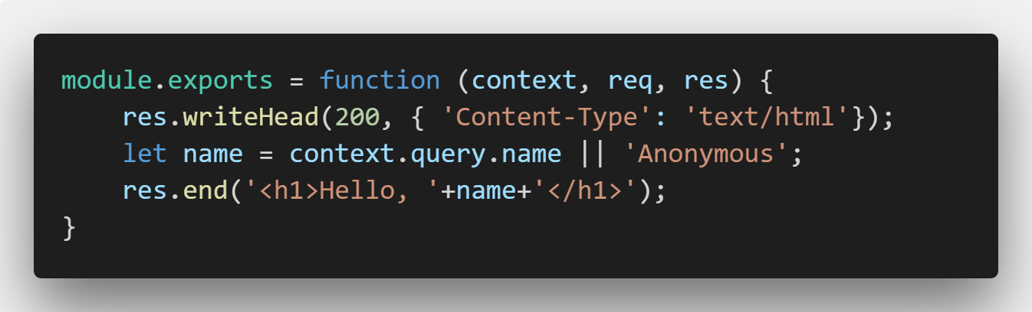
Full HTTP Control

Slide 35
Context
Query params (context.query)
Body params (context.body)
Headers (context.headers)
Meta (context.meta)
Secrets (context.secrets)

